Slide 1
CLASSIFICATION OF CLINICAL TWEETS USING APACHE MAHOUT
Li Wang
Department of Computer Science and Electrical Engineering
University of Missouri-Kansas City
December 15th 2014

Slide 2
Overview
1
Introduction
2
Background and Related Work
CONTENT
3
Motivation
4
Design and Implementation
5
Performance Evaluation
6
Conclusion and Future Work
MS Thesis Defense of Li Wang
2

Slide 3

Introduction
Every day, large amount of clinical tweets are posted on Twitter
Classify clinical tweets so that they can be readily consumed by new healthcare applications
Traditional methods may not scale up well when the dataset size largely increases
Demand
New tools and techniques for fast and accurate classification

Slide 4

Background
Twitter
SNOMED CT
Mahout
Hadoop

Slide 5
Background
Twitter
An online social networking and microblogging service
Enable its users to send and read text-based messages of up to 140 characters, known as “tweets”
Large number of active users
Over 270 million active users as of 2013
Large number of active tweets
Generating over 400 million tweets daily
Various useful APIs (SEARCH, STREAM)
Hashtag #

Slide 6

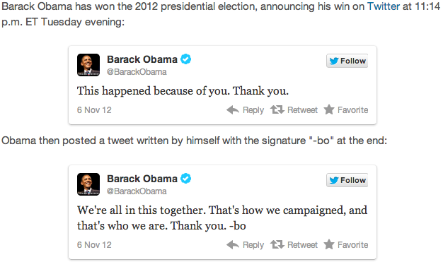
Obama on Twitter

Slide 7
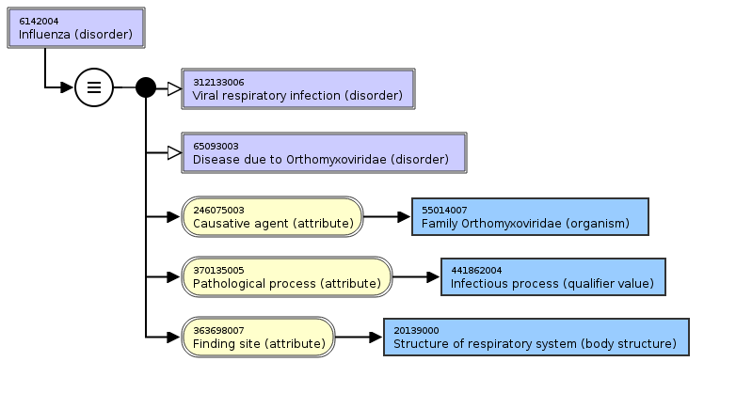
Background
SNOMED CT (Systematized Nomenclature of Medicine - Clinical Term)
Provides terms, synonyms, definitions and relationships
Each term is identified by a unique code
Common language to communicate
Efficient way to index, store and retrieve clinical data
Source: http://browser.ihtsdotools.org/

Slide 8


Background
Apache Mahout
A collection of machine learning algorithms
Written in Java
Built on top of Hadoop
Classification, clustering and recommendation
Apache Hadoop
Open source software project
MapReduce – framework for parallel processing
HDFS – store data on commodity machines
Highly scalable, reliable and efficient

Slide 9
Related Work (1/2)
“Twitter trending topic classification” [Kathy et.al., 2011]
Classify Twitter trending topics into generic categories
“A model for mining public health topics from Twitter” [Paul et.al., 2012]
Discover health topics from Twitter
“Scalable sentiment classification for Big Data analysis using Naïve Bayes Classifier” [Liu et.al., 2013]
Mine sentiments from massive dataset

Slide 10
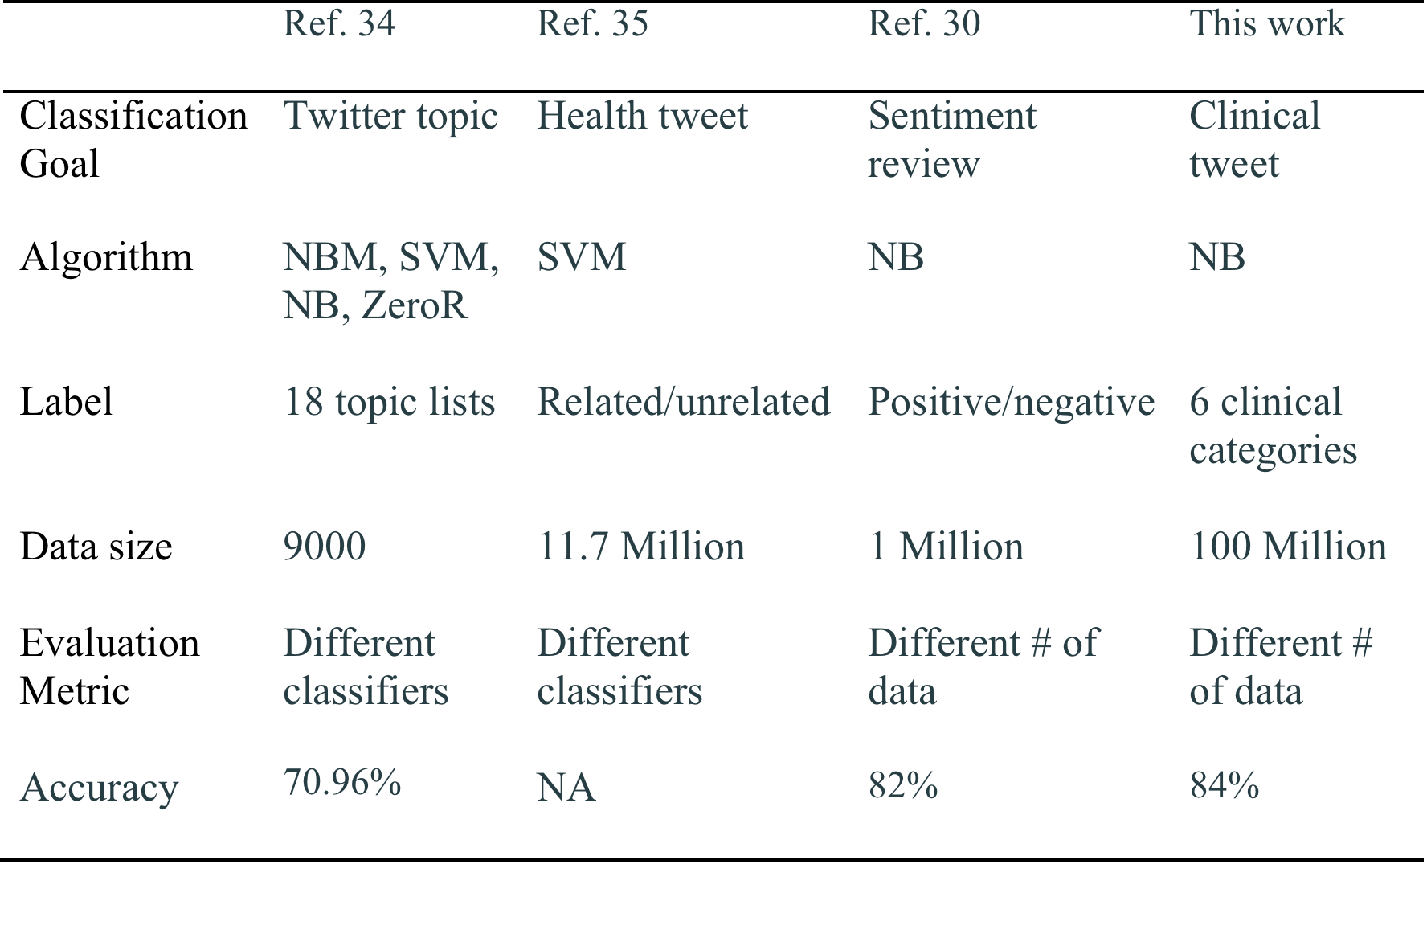
Related Work (2/2)
Comparison between previous studies and this work
[Kathy et.al., 2011]
[Paul et.al., 2012]
[Liu et.al., 2013]

Slide 11



Our Motivation
Healthcare topics
Text contents
Large datasets
Design a solution to enable scalable classification of clinical contents on Twitter

Slide 12

CTC
Clinical Tweets Classifier (CTC),a new tool to enable scalable classification of clinical contents on Twitter
1
Extract clinical contents
Download tweets into local machine using Twitter Streaming API
2
Collector
SNOMED CT
CTC
Components
Tweet
Influence
Mahout
/Hadoop
Construct high accurate models
Perform classification jobs in Hadoop cluster
4
3

Slide 13
Data Collector
Collected data description
Number of tweets | Dataset size
42 million | 2.8 GB
From Sep. 2012 to Apr. 2014
42 million tweets have been collected into local machine
The topics of the tweets are not restricted to healthcare
How to extract clinical data from the collected tweets to build classification model ?

Slide 14
Extract Clinical Tweets
Use of SNOMED CT
Choose 4 most common diseases for each related organ
Use organs and related diseases to query the tweets
Organ | Disease
Brain | Brain tumor, Meningitis, stroke, epilepsy
Heart | Cardiovascular injury, coronary disease, myocardial infarction, atherosclerosis
Stomach | Gastric ulcer, gastritis, gastric cancer, gastric polyp
Lung | Pneumonia, influenza, asthma, bronchitis
Kidney | Nephritis, renal failure, nephrotic syndrome, renal stone
Colon | Appendicitis, Enteritis, constipation, diarrhea

Slide 15
Feature
Features to extract clinical data
Feature | Query with feature
H_{O} H_{O} + H_{D} H_{O} + W_{O} H_{O} + W_{O} + H_{D} + W_{D} | Return tweets exact match with organ hashtag Return tweets exact match with organ or disease hashtag Return tweets exact match with organ keyword or hashtag Return tweets exact match with organ keyword or hashtag, disease keyword or hashtag
H: Hashtag, W: Keyword
O: Organ, D: Disease
Feature | Example of returned tweets
H_{O} H_{O} + H_{D} H_{O} + W_{O} H_{O} + W_{O} + H_{D} + W_{D} | so close! #heart attack I heard they cause #diarrhea Long-lost relative donates kidney Jessie J had a stroke when she was only 18
4 datasets are created by applying different features

Slide 16
Tweet Influence Score
Influence(T) = V_{h} × W_{h} + V_{t} × W_{t} + V_{s} × W_{s} + V_{f} × W_{f} + V_{d} × W_{d} + V_{l} × W_{l} (0 ≤ Influence(T) ≤ 100)
V: value, W: weight
h: hashtag, t: retweet, s: status, f: follower, d: friend, l: list
(0 ≤ V_{i} ≤ 100)
Field | Description
Hashtag Retweet Status Follower Friend List | The topics and keywords The content-oriented quality The frequency of updates The number of information receivers The number of information receivers The popularity of the accounts

Slide 17
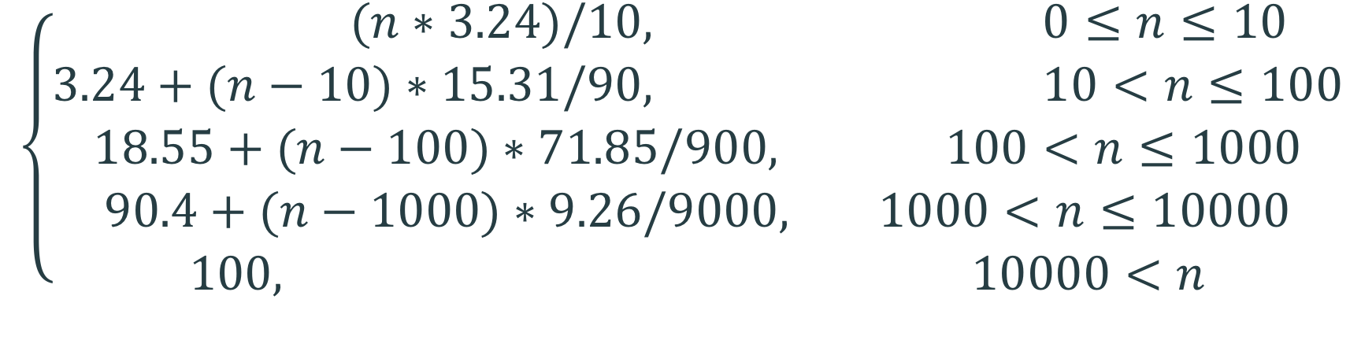
Value of Friend Field
Percentage of the number of friends in different intervals
Interval | [0,10] | (10, 100] | (100, 1k] | (1k, 10k] | (10k, ∞)
Percentage | 3.24% | 15.31% | 71.85% | 9.26% | 0.34%
V_{d} =
n = 800
Example:
1. Sum of previous interval values
2. Relative value in current interval
100
1000
When n = 800
V_{d} = 18.55 + (800 – 100)*71.85/900
= 74.43
71.85

Slide 18
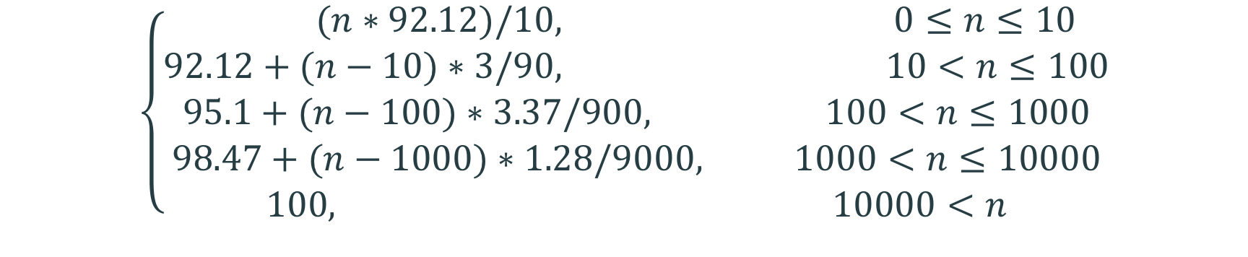
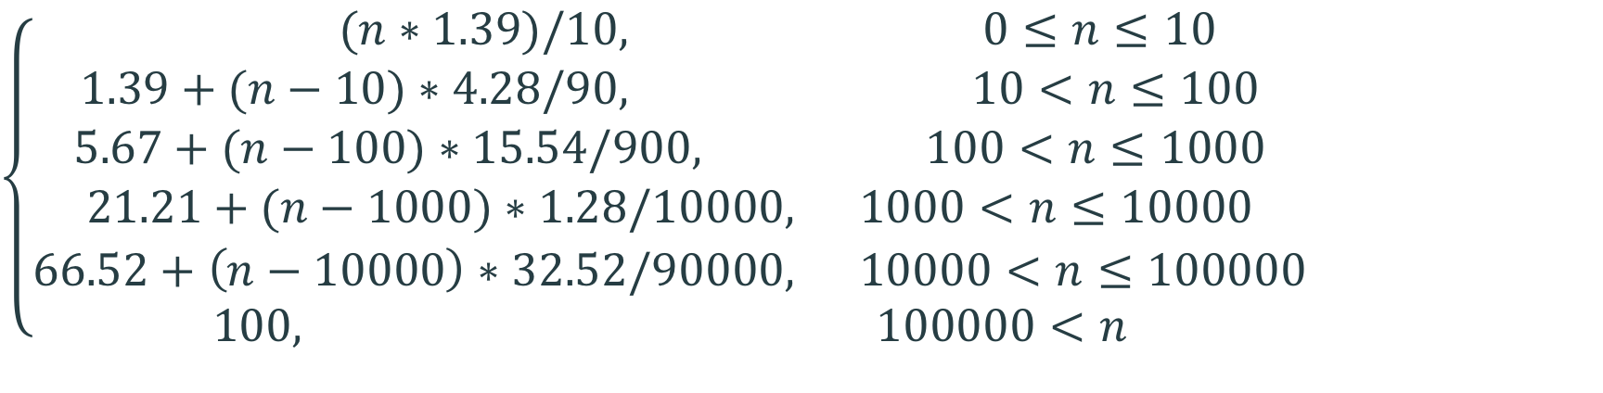
Tweet Influence Score
Percentage of the number of retweets in different intervals
Interval | [0,10] | (10, 100] | (100, 1k] | (1k, 10k] | (10k, ∞)
Percent | 92.12% | 3% | 3.37% | 1.28% | 0.23%
V_{t} =
Percentage of the number of statuses in different intervals
Interval | [0,10] | (10, 100] | (100, 1k] | (1k, 10k] | (10k, 100k) | (100k, ∞)
Percentage | 1.39% | 4.28% | 15.54% | 45.31% | 32.52% | 0.96%
V_{s} =

Slide 19
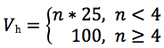
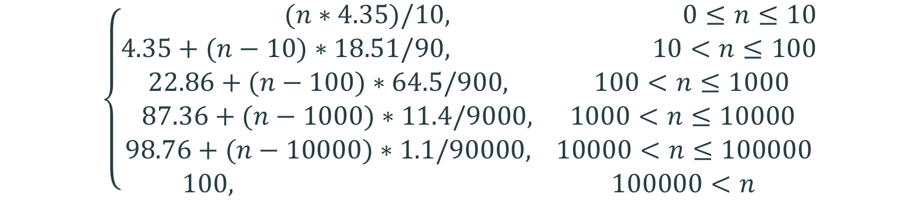
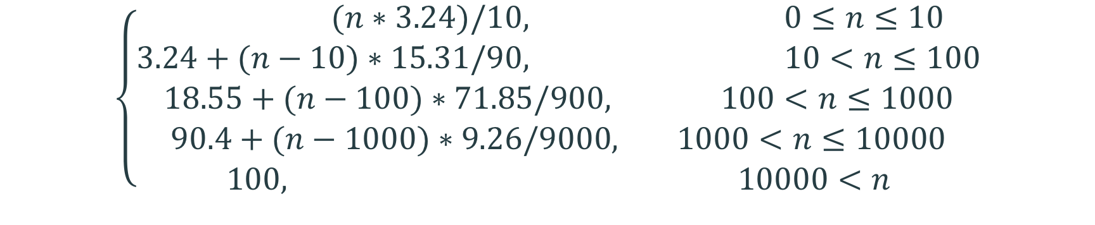
Tweet Influence Score
Percentage of the number of lists in different intervals
Interval | [0,10] | (10, 100] | (100, 1k] | (1k, ∞]
Percentage | 90.58% | 7.63% | 1.62% | 0.17%
V_{l} =
Percentage of the number of followers in different intervals
For hashtag value:
Interval | [0,10] | (10, 100] | (100, 1k] | (1k, 10k] | (10k, 100k) | (100k, ∞)
Percentage | 4.35% | 18.51% | 64.5% | 11.4% | 1.1% | 0.14%
V_{f} =

Slide 20
Tweet Influence Score
Weight for each field
Field | Hashtag | Retweet | Status | Follower | Friend | List
Weight | 0.1 | 0.05 | 0.2 | 0.25 | 0.25 | 0.15
Example:
Hashtag | Retweet | Status | Follower | Friend | List
2 | 3 | 41451 | 947 | 633 | 6
1
Step1: Calculate the value for each field
Step2: Sum up the weighted values
V_{h} = 50
V_{r} = 27.64
V_{s} = 80
V_{f} = 83.94
V_{d} = 64.03
V_{l} = 54.35
2
Influence(E) = 50*0.1 + 27.64*0.05 + 80*0.2
+ 83.94*0.25 + 64.03*0.25 + 54.35*0.15
= 67.53

Slide 21


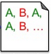
CTC: Classification Workflow
1
Training Dataset
Model Training
Clinical Tweets
Raw Data
SNOMED CT
2
Tweet Score
Testing Dataset
Model Testing
Twitter Restful API
3
Input Data
Trained Model
Output

Slide 22
Model Training
Training dataset: TSV file
Category | Tweet Content
stomach kidney heart colon brain kidney | not feeling good #back #stomach #pain Long-lost relative donates kidney so close! #heart attack I heard they cause #diarrhea Jessie J had a stroke when she was only 18 Rapid recovery after #kidney #transplant
Training dataset:
6 categories has been defined
Category followed by tweet content, separated by tab
Build the model using training dataset

Slide 23
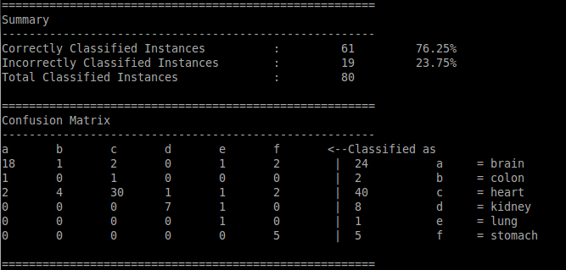
Model Testing
The label assigned to each tweet by the model will be compared to the associated correct label
The percentage of correctly classified instances and a matrix will be generated for validate the model

Slide 24
Classify New Data
Brain
Heart
Stomach
Input
Tweets
Model
Lung
Kidney
Colon

Slide 25
CTC Evaluation
3 workloads to evaluate CTC
W1 – measure the performance of 4 models
W2 – measure the performance of tweet influence
W3 – measure the scalability
Model | Number of tweets | Feature
1 2 3 4 | 684 1433 132,742 141,684 | H_{O} H_{O} + H_{D} H_{O} + W_{O} H_{O} + W_{O} + H_{D} + W_{D}

Slide 26
CTC: Classification Performance
Workload W₁
Experiment | Model | Training set percentage | Testing set percentage
1 2 3 4 5 6 7 8 9 10 11 12 13 14 15 16 | M1 M1 M1 M1 M2 M2 M2 M2 M3 M3 M3 M3 M4 M4 M4 M4 | 90% 70% 50% 30% 90% 70% 50% 30% 90% 70% 50% 30% 90% 70% 50% 30% | 10% 30% 50% 70% 10% 30% 50% 70% 10% 30% 50% 70% 10% 30% 50% 70%

Slide 27
Result for W₁
The accuracy increased as the ratio of training dataset to testing dataset increased within each model
The accuracy increased as the number of relevant features increased across all the models
Model 4 produced the highest accuracy – 84%

Slide 28
Result for W₁
Measured the time to upload data, train and test the model
Time to complete each classification was under 10 minutes

Slide 29
Build Models By Tweet Influence Score
Dataset(unsorted)
Top 50%
influential tweets
Tweet1 76
Unsorted influence score
Sorted Dataset
Sorted influence score
Tweet2 43
Tweet8 91
Training Dataset1
Tweet3 37
Tweet9 87
Tweet8 91
Tweet4 54
2
Tweet5 81
Tweet9 87
Tweet5 81
Tweet1 76
Tweet5 81
Tweet6 67
Tweet6 67
Tweet1 76
Tweet7 73
Tweet4 54
3
Tweet8 91
Tweet2 43
Bottom 50%
influential tweets
Tweet9 87
Tweet3 37
Tweet10 69
Training Dataset2
1
Tweet6 67
Testing Dataset
Tweet4 54
3. Split the sorted tweets into 2 parts
Randomly select some tweets to create testing dataset
2. Sort the remaining tweets by tweet influence score
Tweet7 73
Tweet2 43
Tweet10 69
Tweet3 37

Slide 30
CTC: Tweet Influence Evaluation
Workload W₂
Classification | Model | Training set | Number of Tweets in testing set
17 18 19 20 21 22 23 24 | M1 M1 M2 M2 M3 M3 M4 M4 | Top 50% influential tweets Bottom 50% influential tweets Top 50% influential tweets Bottom 50% influential tweets Top 50% influential tweets Bottom 50% influential tweets Top 50% influential tweets Bottom 50% influential tweets | 80 80 150 150 12000 12000 13000 13000

Slide 31
Result for W₂
For each pair in 4 models, the classifier trained with top 50% influential tweets always produced higher accuracy
The largest difference is 6% in Model 1
The training dataset created from higher influential tweets are more informative, reliable and accurate

Slide 32
Result for W₂
The time difference between each pair was very close
The processing time increased as the training dataset grew, but not much

Slide 33
CTC Scalability
Workload W₃
Experiment | Model | # of tweets to be classified
25 26 27 28 29 30 | M3 M3 M3 M4 M4 M4 | 1 Million 10 Million 100 Million 1 Million 10 Million 100 Million
Both Model 3 and Model 4 showed good classification accuracy
Use both of them to test CTC scalability
Replicate the data to achieve 100 million tweets

Slide 34
Scalability Evaluation Setup
Hadoop cluster setup
Node | OS | Memory size | Hard drive size | Hadoop version
Master Slave | Ubuntu 12.04 Ubuntu 12.04 | 4 GB 2 GB | 350 GB 80 GB | 1.2.1 1.2.1
Hadoop cluster: 1 Master node, 5 Slave nodes
Default block size: 64 MB
Hadoop classification jobs
Number of tweets | Data size | Number of map tasks | Number of reduce tasks
1 million 10 million 100 million | 82.8 MB 842 MB 8.4 GB | 2 13 126 | 1 1 1

Slide 35
Hadoop MapReduce Framework
Map
Data Node
Map
Reduce
Data Node
Input files
Data Node
Output
files
Map
Data Node
Splits

Slide 36
Result for W₃
Time consumption increased with respect to the dataset size
When the dataset reached to 100 million, the time consumption was less than minutes

Slide 37
Conclusion: CTC
CTC leverages SNOMED CT and Tweet influence score
Construct high accuracy models – 84%
CTC is based on Hadoop MapReduce framework
Easily and efficiently scale up to handle 100 million tweets
CTC turns out to be a promising solution for clinical data classification on large-scale datasets

Slide 38
Future Work
Include more algorithms and compare them with Naïve Bayes
Explore the capacity of Hadoop with more data
Release this tool

Slide 39
Acknowledgements
Thesis advisor
Praveen Rao, Ph.D. (Committee Chair)
Committee members
Yugyung Lee, Ph.D.
Yongjie Zheng, Ph.D.
Lab mates
Anas Adnan Katib
Vasil Slavov
Support
National Science Foundation Grant No. 1115871

Slide 40
Reference
E. Bakshy, et al. “Everyone's an influencer: quantifying influence on twitter,” Proceedings of the fourth ACM international conference on Web search and data mining, pp. 65-74, 2011.
M. Trusov , et al. “Determining influential users in internet social networks,” Journal of Marketing Research, vol. 47, no. 4, pp. 643-658, 2010.
M. Lin, et al. “The design and implementation of distributed mobile points of interest (POI) based on Mahout,” In Pervasive Computing and Applications (ICPCA), 2011 6th International Conference on IEEE, pp. 99-104, 2011
L. Bingwei, et al. “Scalable sentiment classification for Big Data analysis using Naïve Bayes Classifier,“ Big Data, 2013 IEEE International Conference on. IEEE, pp. 99-104, 2013
U. Fayyad, et al. “Evolving data into mining solutions for insights,” Communications of the ACM, vol. 45, no. 8, pp. 28-31, 2002.
J. Dittrich, et al. “Efficient big data processing in Hadoop MapReduce,” Proceedings of the VLDB Endowment, vol. 5, no. 12, pp. 2014-2015, 2012.
M. Cha, et al. “Measuring User Influence in Twitter: The Million Follower Fallacy,” Icwsm, vol. 10, pp. 10-17, 2010.
M. J. Paul, et al. “A model for mining public health topics from Twitter,” Health, vol. 11, pp. 16-6, 2012.
L. Kathy, et al. “Twitter trending topic classification“ Data Mining Workshops (ICDMW), 2011 IEEE 11th International Conference on. IEEE, pp. 251-258, 2011

